Slide 1
Getting a grip on recursion
“To understand recursion, one must first understand recursion”
Terence Parr
MSDS program University of San Francisco

Slide 2
Recursion is just delegation
Consider an org chart
Bosses delegate to subordinates
CEO wants work done:
sends emails to 2 VPs
who launch 2 other workers
those workers launch emails too
until potentially all n contacted
Max work is n workers times work each worker performs
Trace from CEO to mailroom cost is only height of org chart: log(n) in typical case
Jeff

Slide 3
Recursion is more like startup org chart
One person has to play every role, cloning themselves
Person ”pauses” current work, performs subtask(s), then continues where they left off, possibly using subtask results
Each call or email to worker is analogous to a function call
(A large company could launch multiple core/employees)

Slide 4
Let’s start with math recurrence relations
Factorial definition:
Let 0! = 1
Define n! = n * (n-1)! for n>=1
Recurrent math function calls become recursive function call in Python
Non-recursive version is harder to understand and less natural
This has linear time O(n); more clear in non-recursive version
def fact(n):
if n==0: return 1
return n * fact(n-1)
def factloop(n):
r = 1
for i in range(1,n+1):
r *= i
return r

Slide 5
Fibonacci sequence
def fib(n):
if n==0 or n==1: return 1
return fib(n-1) + fib(n-2)
Let F(0) = F(1) = 1
Define F(n) = F(n-1) + F(n-2) for n>=2
Recursive implementation is very natural but mucho inefficient!
We do small bit of work to combine results of two subproblems, and each subproblem is only 1 and 2 elements smaller
Compare this to fact(n) where we do small bit of work using result of a single subproblem, which has linear time

Slide 6
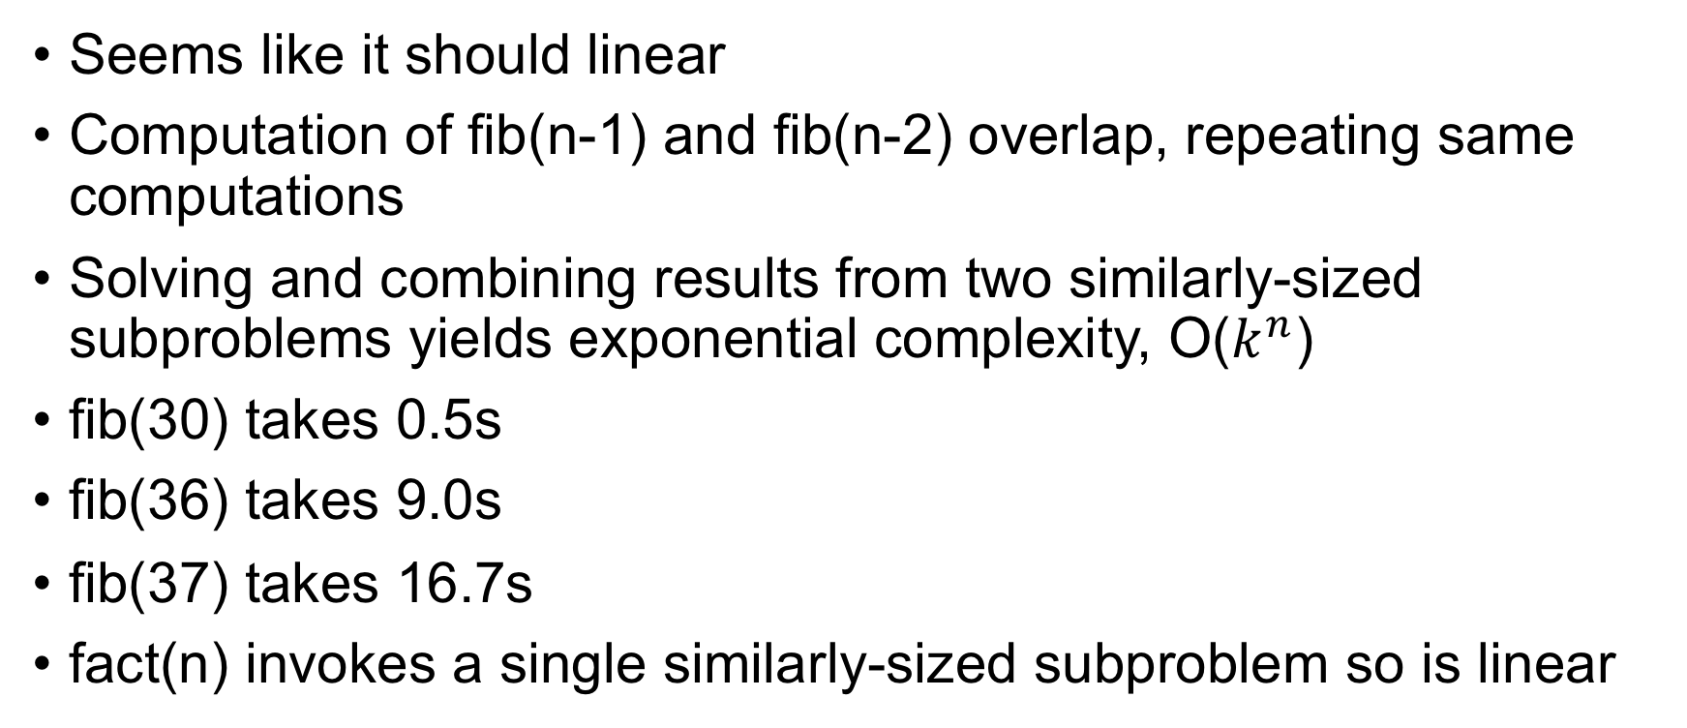
How fast is fib(n)?
Seems like it should linear
Computation of fib(n-1) and fib(n-2) overlap, repeating same computations
Solving and combining results from two similarly-sized subproblems yields exponential complexity, O($k^{n}$)
fib(30) takes 0.5s
fib(36) takes 9.0s
fib(37) takes 16.7s
fact(n) invokes a single similarly-sized subproblem so is linear

Slide 7
Compare fact, fib call trees visually
Difference comes down to two versus one subproblem!
Key idea: recursion traces out a tree of function calls, meaning recursion is most natural way to walk trees

Slide 8
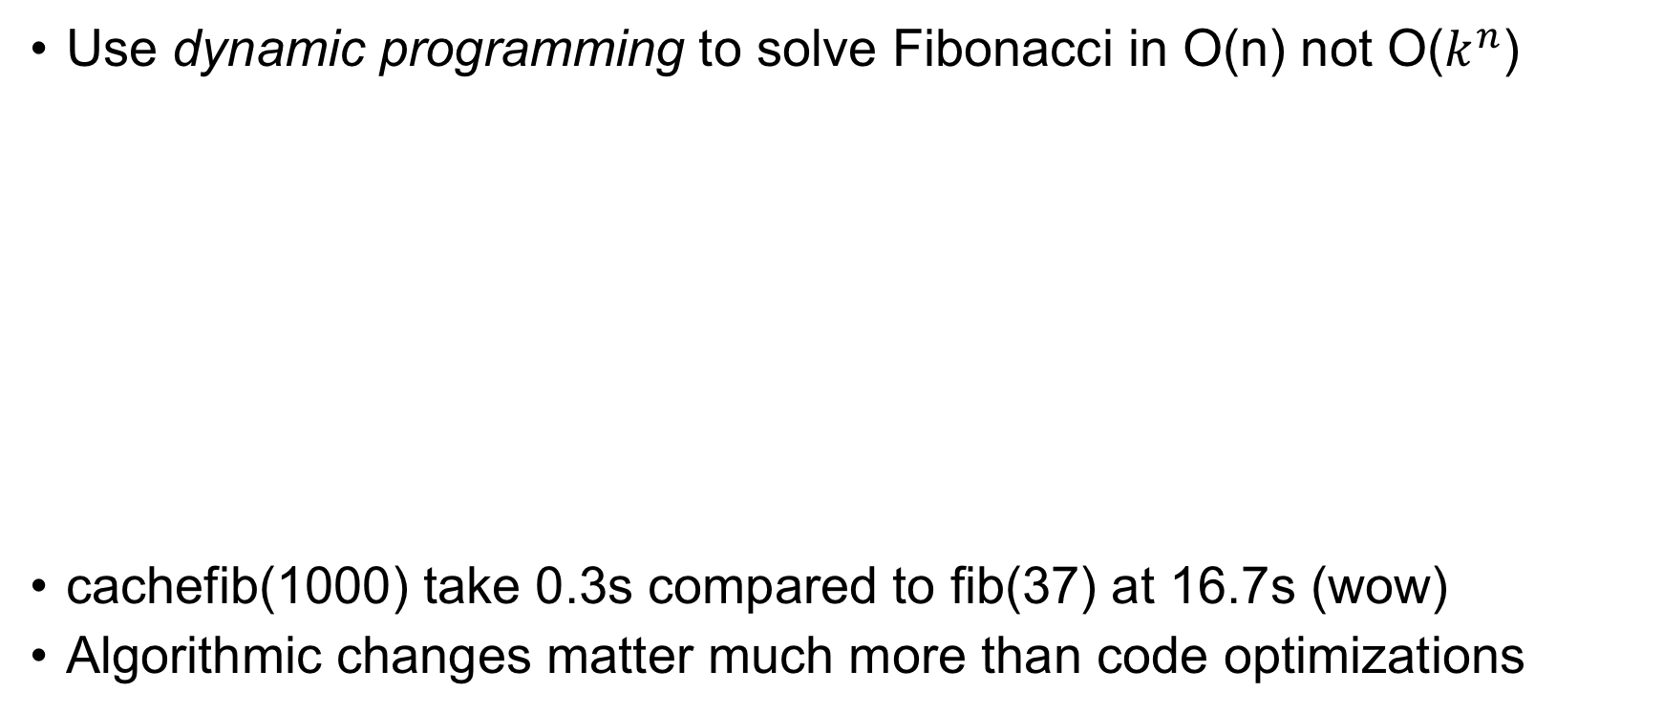
An aside: Trade memory for speed
Use dynamic programming to solve Fibonacci in O(n) not O($k^{n}$)
cachefib(1000) take 0.3s compared to fib(37) at 16.7s (wow)
Algorithmic changes matter much more than code optimizations
def cachefib(n):
F = [0 for i in range(n+1)]
F[0] = F[1] = 1
for i in range(2,n+1): # work up not down
F[i] = F[i-1] + F[i-2]
return F[n]

Slide 9
Summary: formula for recursive functions
def f(input):
1. check termination condition
2. process the active input region / current node, etc…
3. invoke f on subregion(s)
4. combine and return results
Steps 2 and 4 are optional
def fact(n):
if n==0: return 1
return n * fact(n-1)
def fib(n):
if n==0 or n==1: return 1
return fib(n-1) + fib(n-2)
Terminology: currently-active region or element is what function is currently trying to process.
Here, that is argument n (the “region” is the numbers 0..n)

Slide 10
Recursion at its finest: Divide and conquer
The big idea: break a big problem down into smaller subproblems via recursion until subproblems are so small we can solve in constant time; then, merge partial results in linear time as you climb back up the recursive calls
Examples: merge sort, quick sort, decision tree construction
Recursion is easiest way to describe algorithms that break problems into multiple subproblems
In contrast, algorithms that use a single recursive call are easy to convert to loops, and loops are usually more efficent

Slide 11
The nature of divide and conquer alg’s
Divide and conquer algorithms make 2 or more recursive calls where each subproblem is a fraction of the size of the currently active problem
(Binary search splits problem in half each step but it descends into just one half with one recursive call not two and it doesn’t merge results; technically, not divide and conquer…just divide)
The cost of any recursive algorithms depends on:
the number of recursive subproblem calls per active region
the size of the subproblems; for example, n-1 or n/2 for active size n?
the work required for each active region

Slide 12
Example:Merge sort O(n log n)
https://www.geeksforgeeks.org/merge-sort/
The idea is to split the currently active region in half, sorting both the left and right subregions, then merge the two sorted subregions
Eventually, the regions are so small we can sort in constant time; i.e., sorting 2 nums is easy
Merging two sorted lists can be done in linear time

Slide 13
Walking binary tree
First, recall node def:
class TreeNode:
def __init__(self, value, left=None, right=None):
self.value = value
self.left = left
self.right = right

Slide 14
Recursive walk is the most natural
“Depth-first search” is how we walk every node in a tree
The visitation order (discover, finish nodes) always same
Traversal (pre-, in-, post-) depends on action location
def walk_tree(p:TreeNode):
if p is None: return
print(p.value) # preorder
walk_tree(p.left)
walk_tree(p.right)
def walk_tree(p:TreeNode):
if p is None: return
walk_tree(p.left)
walk_tree(p.right)
print(p.value) # postorder

Slide 15
Recursion summary
Use recursion when implementing a recurrence relation (not always for efficiency reasons, such as gradient descent)
Use recursion when you can break problem down into subproblems whose results can be merged to solve overall problem; divide and conquer
Use recursion when the same operation and navigation procedure applies to any element of a data structure; binary search, walking trees and graphs; self-similar structures
Recursion traces out a function call tree

